Slide 1
Ethics of clinical trials of new medical equipment
Ethics review boards
Responsibilities of sponsor and host
Phases based on sponsor and host ethics review boards
Risk vs. benefit for host population
17.6.2 Explain ethical dimensions of clinical trials of new medical
equipment in developing countries.
Unit C 17.6 Trends in Medical Research Ethics
Module 279-17-C Regulations, Standards and Ethics
©
dr. Chris R. Mol, BME, NORTEC, 2016

Slide 2
Clinical Trials
Clinical trials are research studies that test how well new medical approaches work in people. Each study answers scientific questions and tries to find better ways to prevent, screen for, diagnose, or treat a disease. Clinical trials may also compare a new treatment to a treatment that is already available.
Every clinical trial has a protocol, or action plan, for conducting the trial. The plan describes what will be done in the study, how it will be conducted, and why each part of the study is necessary. Each study has its own rules about who can take part. Some studies need volunteers with a certain disease. Some need healthy people. Others want just men or just women.
©
Ethics of clinical trials
dr. Chris R. Mol, BME, NORTEC, 2016

Slide 3
Clinical Trials are part of a Medical Research Study
A standard biomedical research study on an ‘Investigational New Drug’ (IND) has the following four phases:
Determine how safe the IND is.
Give the IND to a small number of patients with the targeted disease to determine whether the IND is effective.
Conduct a randomized clinical trial (RCT) of the IND on a large number of patients who have the targeted disease. The purpose of the RCT is to conclusively establish that the IND is at least as good and hopefully better than one of the established effective drugs for the targeted disease.
Monitor whether the IND has any unanticipated, deleterious side effects.
For New Medical Devices the same approach is valid. In practice, drug tests happen more frequently and can have more risks.
Only 10% of all drugs started in human clinical trials become an approved drug.
The ethical issues often focus on phase 3: the Trial
©
Ethics of clinical trials
dr. Chris R. Mol, BME, NORTEC, 2016

Slide 4
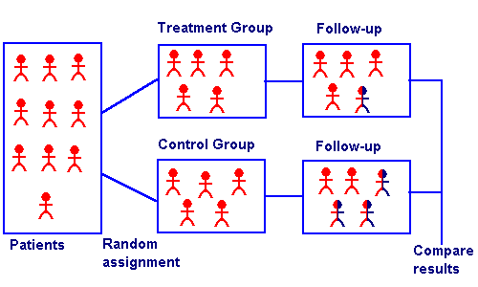
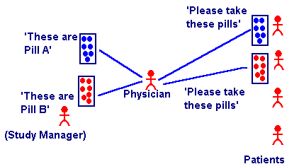
the Randomized Clinical Trial
In the RCT, researchers typically divide subjects into two groups: one (the Treatment Group) receives the IND and the other (the Control Group) receives an established effective drug: the currently best available drug.
If there is currently no established effective drug, the second group receives a placebo: a substance that looks identical to the IND but does not have any pharmacological effect on the condition being treated.
Importantly, most RCT’s are double-blind:
neither the researchers nor the subjects know which drug the subject is receiving !
©
Ethics of clinical trials
dr. Chris R. Mol, BME, NORTEC, 2016

Slide 5
Clinical Trial Ethics: Stopping the trial
One of the most difficult ethical decisions is to stop the study before it has been completed. Suppose that after three quarters of the study it is clear that the IND is far superior to the established effective drug (or placebo). Should the study be stopped immediately and all subjects be given the IND?
On the one hand, this would probably help the subjects in the Control Group, on the other hand, the incomplete study would lead to uncertain conclusions.
Currently, the consensus is that the study should be stopped if this concerns a life threatening disease and that all subjects should be given the IND.
©
Ethics of clinical trials
dr. Chris R. Mol, BME, NORTEC, 2016

Slide 6
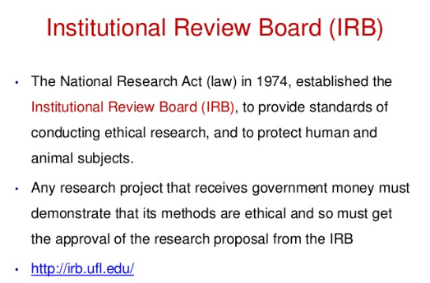
Ethics Review Boards
In many countries… the law now requires that every medical Research Institution has an Ethics Review Board to oversee (and approve) the ethics side of all animal and human Research protocols that are carried out in this institution.
The composition of such a Board typically includes scientists as well as non-scientists and also a community member who is not affiliated with the Institute.
Its role is to:
Make sure that the study is ethical
Protect the rights and welfare of the participants
Make sure that the risks are reasonable when compared to the potential benefits
In the USA, a clinical trial must have an IRB if it is studying a drug, biological product, or medical device that the Food and Drug Administration (FDA) regulates, or it is funded or carried out by the federal government.
©
Ethics of clinical trials
dr. Chris R. Mol, BME, NORTEC, 2016

Slide 7
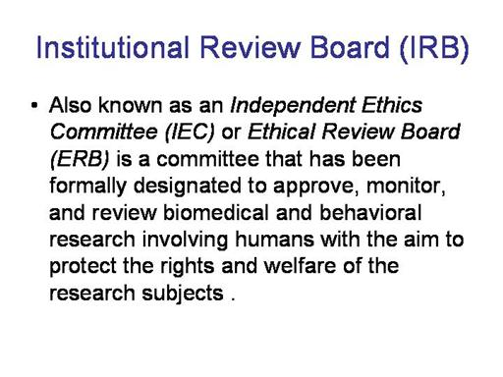
Ethics Review Boards
U.S. recommendations suggest that Research and Ethical Boards (REBs) should have five or more members, including at least one scientist, one non-scientist, and one person not affiliated with the institution. The REB should include people knowledgeable in the law and standards of practice and professional conduct.
The European Forum for Good Clinical Practice (EFGCP) suggests that REBs include two practicing physicians who share experience in biomedical research and are independent from the institution where the research is conducted; one lay person; one lawyer; and one para-medical professional, e.g. nurse or pharmacist. They recommend that a quorum include both sexes from a wide age range and reflect the cultural make-up of the local community.
Does Zambia need an Ethics Review Board ?
©
Ethics of clinical trials
dr. Chris R. Mol, BME, NORTEC, 2016

Slide 8
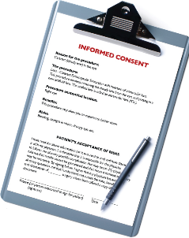
Informed Consent
Informed Consent forms usually require:
an explanation of the purpose(s) of the research
the expected duration of the research
a full description of the procedures involved
a disclosure of the research design
Researchers must be sure that subjects are truly informed: that they understand the risks and benefits to which they will be exposed. Are the risks large or small? Are they likely or unlikely? Are they physical or emotional? Is there a chance that the subject’s life may be threatened? Are the benefits direct (a cure) or aspirational (helping fellow sufferers done the line)?
Researchers must disclose to the subjects the appropriate alternative procedures or courses of treatment, including non-participation in the study. Researchers must disclose to subject whether the information gathered will remain entirely anonymous or simply confidential.
Subjects must be compensated for participating in the study, especially if these require a lot of time. However, researchers may not ‘buy’ the cooperation of the participants, suppressing their free will.
©
Ethics of clinical trials
dr. Chris R. Mol, BME, NORTEC, 2016

Slide 9
Clinical Trials in Developing Countries
Council for International Organizations of Medical Sciences
1993 Guidelines:
The Ethical implications of research involving human subjects are identical in principle
wherever the work is undertaken;
They relate to respect for the dignity of each individual subject as well as to respect for communities,
and protection of the rights and welfare of human subjects.
How does this work out in practice?
©
Ethics of clinical trials
dr. Chris R. Mol, BME, NORTEC, 2016

Slide 10
Informed Consent in developing countries
Informed Consent may not work well in developing nations because of cultural differences. For example, in some developing nations decisions are made communally rather than individually. In others, individuals may feel obligated to give or withhold consent to please elders, spouses or their entire community.
Special problems for illiterate subjects or subjects from populations with very different beliefs about causes of illness and little familiarity with biomedicine, let alone concepts such as randomization and the placebo effect.
Problems with fears of signing a consent form, worrying that doing so may result in unanticipated harm befalling them in the future.
Therefore, to make sure subjects really understand and consent to being in a study, researchers may have to present information and document consent in novel ways. For example:
‘although I as a doctor believe that the disease is caused by germs, I understand that you believe that it is caused by a demon. I respect the fact that you have this belief and I should like you to try this medicine to remove the disease. Removing the disease is more important to us both than whether we think it is caused by germs or a demon.’
©
Ethics of clinical trials
dr. Chris R. Mol, BME, NORTEC, 2016

Slide 11
Further cultural differences
Culture differences can create difficult medical ethics problems. Some cultures have spiritual or magical theories about the origins of disease, for example, and reconciling these beliefs with the tenets of Western medicine can be difficult.
Truth-telling: Some cultures do not place a great emphasis on informing the patient of the diagnosis, especially when cancer is the diagnosis. American culture rarely used truth-telling especially in medical cases, up until the 1970s. In American medicine, the principle of informed consent now takes precedence over other ethical values, and patients are usually at least asked whether they want to know the diagnosis.
There is also the conflict with physicians who are tempted to report made up incidents or make an incident worse than what it was for their own personal motives. In vice versa, a physician might be hesitant to report an incident because of a personal friendship he or she may have with his colleague.
Other issues:
financial liabilities in case the patient gets problems
the right of the patient to refuse or withdraw from the study (without losing benefits)
©
Ethics of clinical trials
dr. Chris R. Mol, BME, NORTEC, 2016

Slide 12
Confidentiality
http://www.nap.edu/read/10405/chapter/4#87
What if the research shows e.g.
a study of sexual behavior may reveal unexpectedly high rates of extramarital affairs among the women. Would it be ethical for the information to be released to the men of the community if it puts the women at risk?
or that the prevalence of aids is higher than expected?
Balancing two legitimate interests:
openness for the sake of science
concealment of information out of respect for subjects.
Who should have access to certain information and who should have the right to agree or disagree to have that information used for various purposes.
Who should ultimately have the power to decide about the publication of certain data? Does the host community should have a say in the matter?
©
Ethics of clinical trials
dr. Chris R. Mol, BME, NORTEC, 2016

Slide 13
Continued Access to treatment
Declaration of Helsinki: “At the conclusion of the study, every patient entered into the study should be assured of access to the best proven prophylactic, diagnostic and therapeutic methods identified by the study”
If upheld, the mandate that investigators provide their participants with access to the best proven intervention—which often far exceeds the community standard of care and is likely to be unsustainable over the long term— may limit the types of research that can be conducted in the developing country context beyond the exploitative situations that the mandate is meant to prevent.
Researchers and sponsors in the clinical trials should make reasonable, good faith efforts before the initiation of a trial to secure, at its conclusion, continued access for all participants to needed experimental interventions that have been proven effective for the participants. . . . Research protocols should typically describe the duration, extent, and financing of such continued access.
Why adopt this paternalistic approach? Why should local ERBs not make these decisions?
©
Ethics of clinical trials
dr. Chris R. Mol, BME, NORTEC, 2016

Slide 14
Responsibilities of sponsor and host
An external sponsoring agency (e.g. the pharmaceutical company) should submit the research protocol to ethical and scientific review in the (home) country of the sponsoring agency and according to the standards of that country, and the ethical standards applied should be no less exacting than they would be for research carried out in that country. Ethical reviewers in the sponsoring countries have the task to ensure compliance with broad ethical standards.
This guideline suggests that it is unethical to conduct research in a particular country if the study in question would not receive the approval of the ethical review board of the sponsoring agency.
Appropriate authorities of the host (e.g. developing) country, including a national or local ethical review committee or its equivalent, should ensure that the proposed research meets their own ethical standards. The host country committees are responsible for determining whether the research objectives are responsive to the needs and priorities of the country.
©
Ethics of clinical trials
dr. Chris R. Mol, BME, NORTEC, 2016

Slide 15
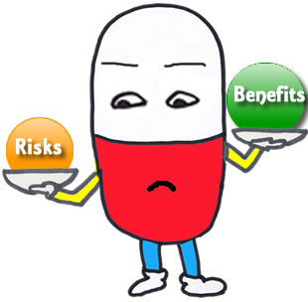
Risk vs. benefit for host population
Some studies will have benefits for the host population; some may not.
Ethical principles dictate that there should be a positive result from the risk versus benefit for the host population.
Some ethicists will argue that it is not permissible to do studies that do not benefit the host population at large.
In another view, it should be left to the ethical committee at the host country whether the risk/cost/benefit relation is adequate to be taken up by the country.
Of course, it remains ethically obligatory that individual participants to the study should be well informed and should have informed consent.
©
Ethics of clinical trials
dr. Chris R. Mol, BME, NORTEC, 2016

Slide 16
Case: HIV ‘for the poor’ medicine
A diseased pregnant woman may pass her HIV infection to her child.
There exists a treatment which reduces the chance of this transmission by two thirds. At 800 USD per case, this is too expensive for many developing countries.
Maybe a reduced dose of this medicine will also have benefits (reduce the risk of transmission), at lower cost.
Research question: is the cheap treatment better than nothing ?
Is it ethical research to do a study to compare the cheap treatment with a placebo;
something that would not be done in a Western country
(because there, you would have to compare it to the full dose solution) ?
©
Ethics of clinical trials
dr. Chris R. Mol, BME, NORTEC, 2016

Slide 17
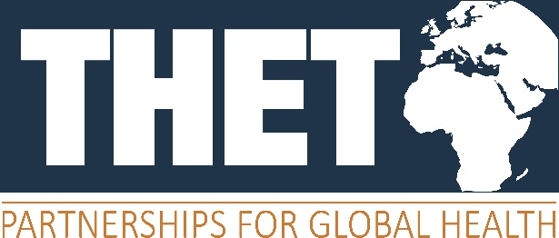
END
The creation of this presentation was supported by a grant from THET:
see https://www.thet.org/

